Slide 1
GitHub Copilot Unveiled: A Beginner’s Guide to QA in Visual Studio Code

Slide 2
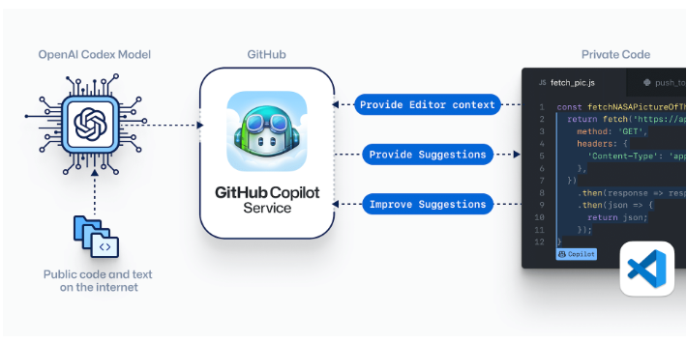
Introduction
GitHub Copilot is an innovative AI-driven coding assistant seamlessly integrated into coding environment like Visual Studio Code. It revolutionizes QA automation by providing intelligent code suggestions, streamlining script development for both beginners and experienced professionals. With real-time examples and seamless integration, it enhances efficiency, enabling QA teams to focus on creating robust test logic.
Significance of GitHub Copilot in Visual Studio Code in QA Perspective:
Efficient Code Creation
Learning Support
Enhanced Test Logic Focus
Consistent Code Quality
Seamless Integration
Productivity Boost
Purpose of GitHub Copilot:
Optimize test script development by leveraging Copilot’s AI-generated suggestions to enhance code efficiency, promote collaborative coding practices, and ensure consistent and high-quality testing within the Visual Studio Code environment
AI-Guided collaborative Code Crafting:
Copilot may assist with some specific coding tasks but AI tool that relies on human developers for guidance and input.

Slide 3
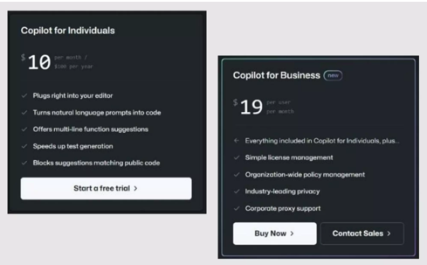

License and Code Accuracy:
GitHub Copilot Licensing:
GitHub Copilot is a Licensing tool
Subscription plans: GitHub copilot free and GitHub copilot pro is a licensing tool
Choose the plans based on needs
Access features per selected subscription.
Code Accuracy:.
Code accuracy with GitHub copilot varies, making it challenging to set a specific expectation; users should anticipate contextually relevant but not flawless code, requiring manual review for optimal results.
Expecting 50% of threshold code accuracy

Slide 4

Features & Significance
 | Feature | Significance
Intelligent Code Suggestions | Copilot offers Context-aware code suggestions | Accelerates script development, reducing manual coding efforts for QA professionals.
Learning Support | Copilot serves as a learning tool, providing real-time examples | Fosters skill development for QA testers, enhancing coding proficiency.
Accelerated Workflow | Copilot handles routine coding tasks | Allows QA professionals to focus more on designing robust test scenarios, improving overall workflow efficiency.
Collaborative Coding | Copilot promotes cohesive and standardized code | Enhances collaboration among QA team members, ensuring consistency in automation projects.
Seamless Integration | Copilot is integrated into Visual studio | Aligns with QA workflows providing a familiar environment and enhancing adaptability.
Productivity Enhancements | Copilot offers instant code completion | Boosts productivity for QA professionals, facilitating efficient creation of test scripts.

Slide 5


Exploring the Advantages and Drawbacks of GitHub Copilot
Pros | Cons
Efficient Coding: GitHub Copilot streamlines code creation, improving efficiency for QAutomation tasks, whether working with an existing project or creating a new one in Visual Studio Code. | Quality Assurance Challenges: Copilot-generated code may require thorough testing to ensure quality and reliability, potentially adding extra steps to a QA process, especially when dealing with projects from other IDEs
Code Exploration and Adaptation: Helps QA professionals navigate and understand code in imported projects, fostering easier integration into the QAutomation workflow. | Dependency Risks: Overreliance on Copilot may discourage manual code review, introducing the risk of overlooking critical testing considerations in QAutomation Scenarios
Time Savings: Accelerates project setup and development, leading to time savings for QAutomation teams | Learning Curve: QAutomation professionals, especially those new to copilot, may face challenges in understanding and validating complex code snippets, impacting the learning curve.
 | Imported Project Compatibility: Issues might arise when importing projects from other IDE’s, including potential conflicts, adjustments needed for the VS Code environment, and debugging efforts to resolve discrepencies,posing challenges in the QAutomation setup.

Slide 6
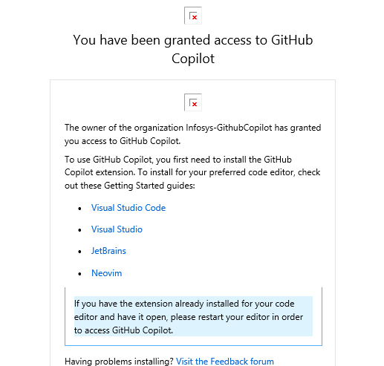
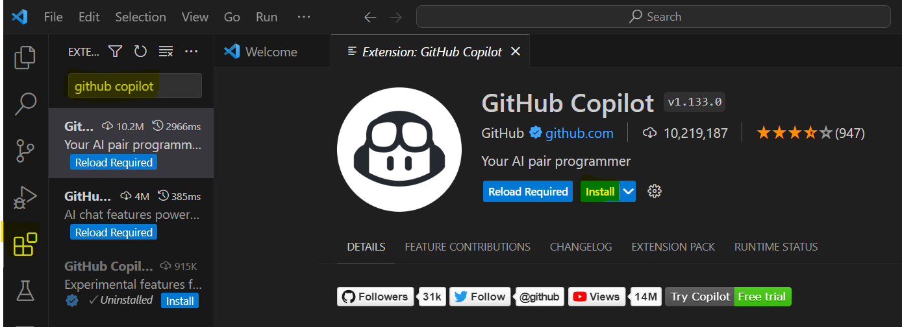
Sign Up for GitHub Copilot
GitHub Copilot Access | UI Screens of GitHub Copilot Access
Access Points: GitHub Copilot is accessed through: Visual Studio Code: As an extension, GitHub Copilot seamlessly integrates into Visual Studio Code. Installation: Access GitHub Copilot by installing it from the Visual Studio Code Extensions marketplace Visual Studio Code Integration: GitHub Copilot becomes an Integral Part of your coding environment in Visual Studio Code: Real-Time Suggestions: It provides context-aware code suggestions as you type. Code-Completion: Enhances coding speed with instant code completion. Collaboration Feature: Git Hub Copilot encourages collaboration through: Shared Code styles: Promotes Cohesive and standardized coding practices. Learning Support: Provides real-time examples, fostering skill development.

Slide 7
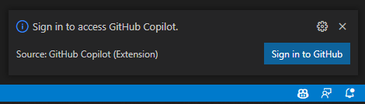
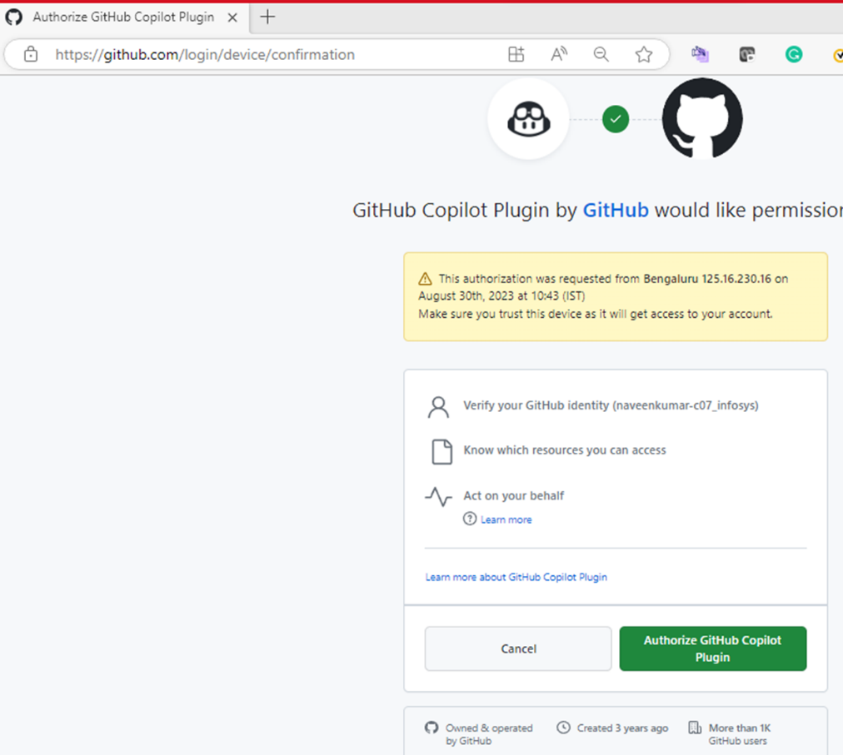
Sign Up for GitHub Copilot
GitHub Copilot Access | UI Screens of GitHub Copilot Access
GitHub Account Integration: To access advanced features an personalized suggestions: GitHub Account: Sign in with your GitHub account for an enhanced copilot experience. Benefits: Accessing GitHub Copilot brings several benefits: Efficient Coding: Accelerates Script development with intelligent suggestions. Learning Aid: Supports skill development with contextual examples Adaptability: Integrates seamlessly into various coding environments. Closing Statement: With GitHub Copilot, accessing advanced coding support has never been easier. Experience a new level of coding efficiency and collaboration with Visual Studio Code. | Complete Installation of GitHub Copilot in VSCode guide: GitHub Copilot Installation Guide

Slide 8



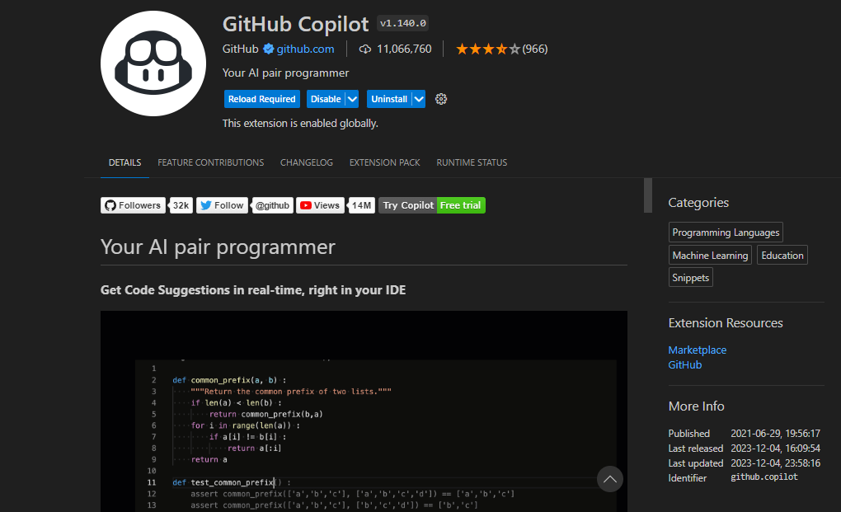
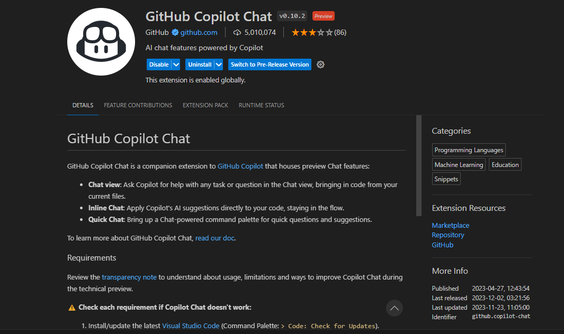
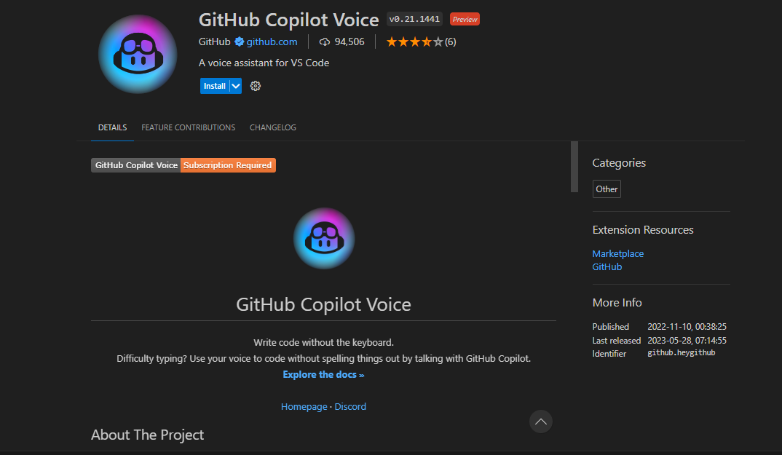
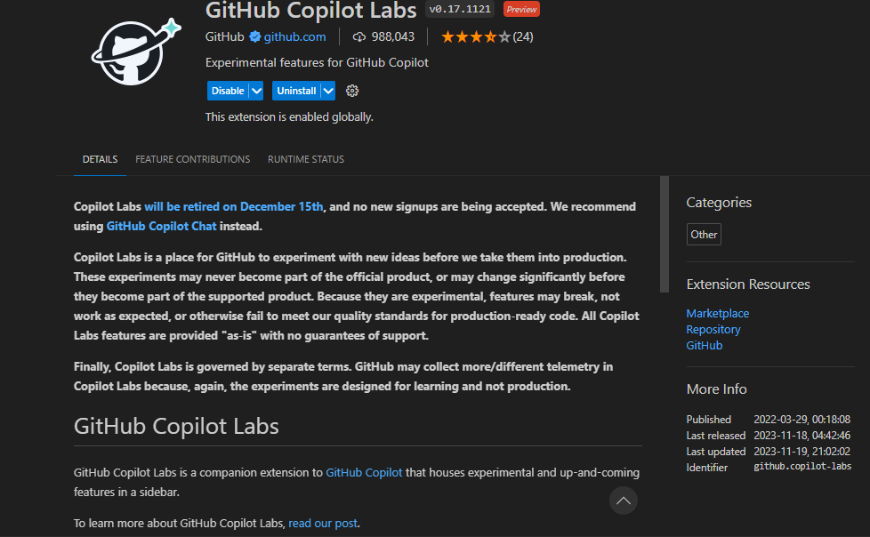
IDEs Compatibility and Extensions
GitHub Copilot can be adapted various coding environments:
Supported IDEs: Visual Studio Code/Jet Brains/Neovim/Codespaces
Languages: Java/Python/JavaScript/C++/TypeScript/HTML/CSS/Ruby/Go/PHP/Swift
GitHub Copilot GitHub Copilot chat
GitHub Copilot Voice GitHub Copilot Labs
Compatibility
Extensions

Slide 9
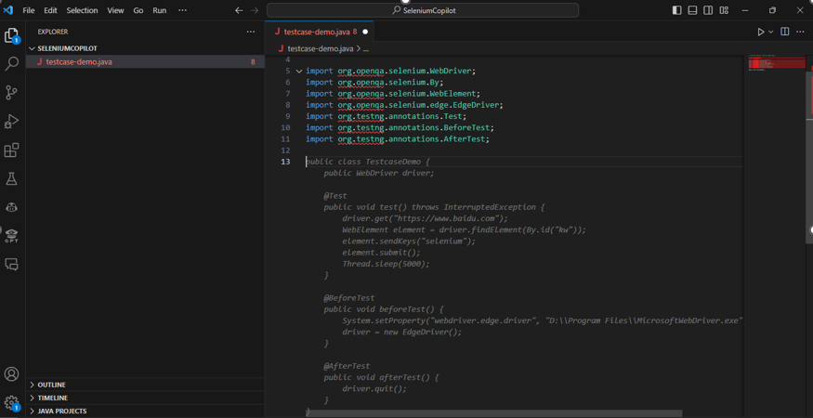
Transformative coding using GitHub Copilot
How Copilot Works:
GitHub Copilot operates by employing machine learning models trained on a vast codebase. As a QA tester writes code in Visual Studio Code, Copilot analyzes the context, including method names, comments, and existing code structures. It then generates suggestions for entire lines or blocks of code based on analysis. The tool’s ability to understand the intended purpose of the code enables it to provide relevant and contextually accurate suggestions. This process not only accelerates coding by automating repetitive tasks but also serves as an educational resource, offering real-time examples and fostering a deeper understanding of coding practice for QA testers.
More Than Autocomplete Streamlining the creation of test scripts through AI-generated code suggestions, reducing manual effort. Copilot uses the context you have provided and synthesizes code to match. Together with OpenAI, we're designing GitHub copilot to get smarter at producing safe and effective code as testers use it. Adaptive Coding : Adapting to various testing scenarios and frameworks, providing flexible solutions for diverse testing needs.

Slide 10
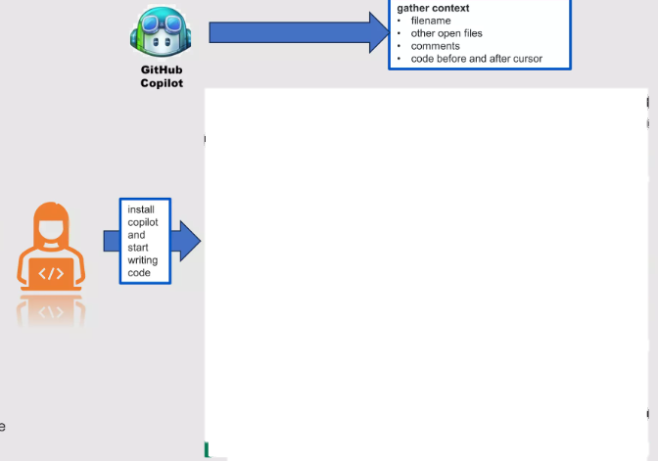
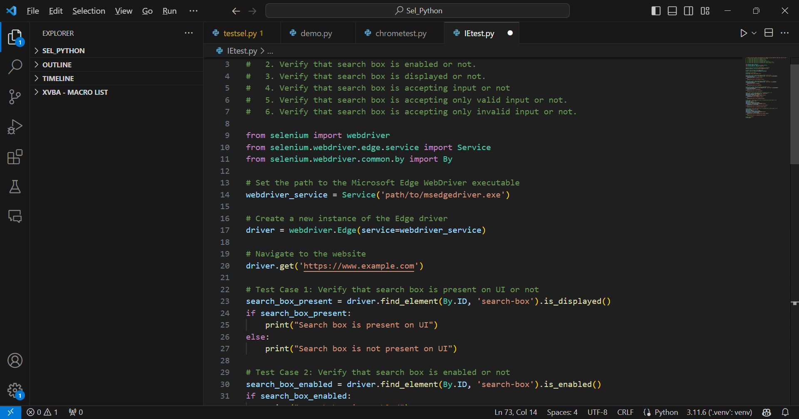
Transformative coding using GitHub Copilot
Convert Comments to Code Write a comment describing the logic you want, let GitHub copilot assemble the code for you Reducing Repetition: Auto-filtering repetitive code patterns, optimizing coding practices for efficiency and maintainability. Tests without toil Enabling the creation of comprehensive test scripts without toil of extensive manual coding. Import test scripts and let the GitHub Copilot suggest tests that match your implementation code.

Slide 11
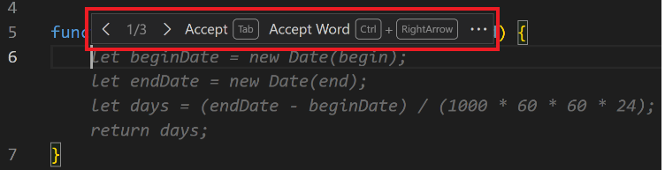
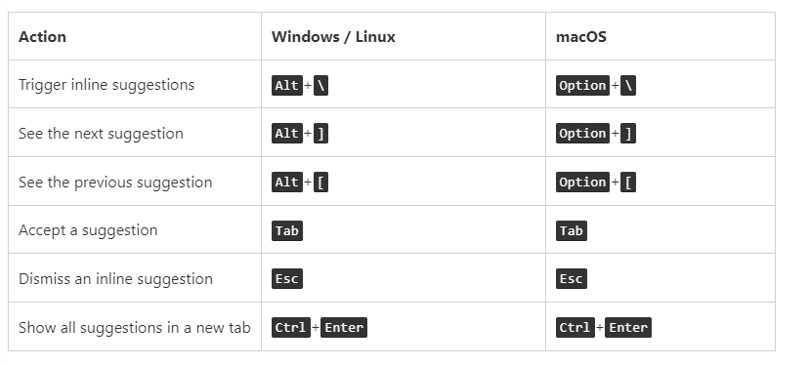
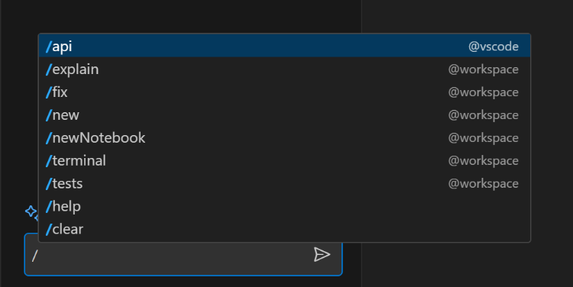
Copilot Keyboard Shortcuts & Slash Commands
Shortcuts & Commands
GitHub Copilot in Visual Studio Code supported below some shortcuts and slash commands: Keyboard shortcuts To make our code more productive ,here the most common keyboard shortcuts worth remembering: Slash Commands: Supported slash commands for specific types of questions or tasks. @workspace /explain: Explain step-by-step how the selected code works. @workspace /fix: Propose a fix for the bugs in the selected code. @workspace /new: Create a new project based on a natural language description. @workspace /newNotebook: Create a new Jupyter Notebook based on your description. @workspace /terminal: Explain how to do something in the integrated terminal. @workspace /tests: Generate unit tests for the selected code. @vscode /api: Questions about VS Code extension development.

Slide 12
Challenges and Solutions
Challenge | Issue | Solution
IDE Transition | Variations in Project Structure between IDE’s | Implement a Systematic review process for smooth transitions, addressing structural differences.
Maven Setup | Copilot’s understanding of Maven intricacies for setup may be limited | Establish a robust Maven setup process guided by QA professionals, ensuring accurate configuration.
Code Consistency | Copilot-generated code may lack consistency across the project. | Conduct regular manual code reviews to identify and address inconsistencies, maintaining coding standards
Version Control | Differences in Version Control strategies between IDE’s. | Align version control mechanisms during export/import and setup processes for consistency.

Slide 13
Challenges and Solutions
Challenge | Issue | Solution
Dependency Management | Handling variations in dependencies during export/import. | Establish a systematic approach to manage dependencies in both environments, ensuring computability. .
Learning Curve | Copilot’s learning curve, especially for new users. | Encourage continuous learning and adaptation to master copilot functionalities for effective project management.
Example: Dependency Variation during export/Import of a Project | Dependency Variation during export/Import of a Project | Establishing a systematic approach to manage dependencies in both environments, ensuring consistency and eliminating dependency-related challenges.

Slide 14
Use Cases of GitHub Copilot
Use Case 1: Setting Up – Selenium Python using GitHub Copilot in Visual Studio Code
Use Case 2: Supports the Robot framework using GitHub Copilot in Visual Studio Code

Slide 15
Conclusion & References
Conclusion:
GitHub Copilot is an innovative and effective tool that can significantly improve the coding experience for developers using Visual Studio Code. It is a impressive tool, it revolutionizes test script development. While it may not provide perfect solutions, its adaptability empowers testers to refine code for specific needs. Leveraging Copilot enhances efficiency, fosters collaboration, and contributes to elevated testing practices.
Striking this balance positions testing teams for enhanced efficiency and innovation in the evolving landscape of software testing.
Reference Links:
https://code.visualstudio.com/docs/editor/github-copilot
How to use GitHub Copilot: Prompts, tips, and use cases - The GitHub Blog
Getting started with GitHub Copilot - GitHub Docs
Use GitHub Copilot to enhance your coding with AI (visualstudio.com)

Slide 16
Thank You

